Slide 1

How to keep pace with learning new technologies
And what I learnt about ML in 3 weeks

Slide 2
structure
The Need
How to do it
Introduction to ML

Slide 3
Why should you bother
How many new domains, technologies or tools have you learnt in last 7 years?
How many technical books have you read recently?
How many courses have you done since your college days?
Notes:
2 – Use of SQL in Sapience product

Slide 4
Why should you bother
You have seen opportunities that look interesting but you don’t meet the technical requirements
You have come across technologies, tools or phrases in your current assignment itself where you cannot make the cut
It is fun to learn new things. It need not be limited to professional life only
Most importantly, it is imperative to keep pace with the changes
Notes:
2 – Use of SQL in Sapience product

Slide 5
My journey and technology landscape
1980 – 85
Mainframe with all of 256 KB core memory
Fortran
Punch cards
1985 – 87
CP/M and Pascal
Debugging using print statements
1987 – 99
Unix and C with very simple debugger (dbg)
CAD and Graphics
Notes:
** Think of a better title
Technologies in IT have been changing at ever increasing pace with current hot technology even becoming forgotten in a few years
(1980-85) Do you remember what “Core” memory referred to?
(1985-87) We didn’t even talk of “domains” in the early days. There weren’t many areas where computers were being used!
(1987-99)

Slide 6
My journey and technology landscape
1999 - 2002
Windows, C++
MS Visual Studio
Storage, Backup
2003 - 2008
Sales and account management
2009-2019
.Net, C#, MS SQL
Product start-up
2018
ML, R
Notes:
** Think of a better title
1999-2002 – Huge change. Changing from Unix to Windows was like changing religion.
Got exposed to a sophisticated / modern IDE for the first time
Command line to GUI based computer usage
I thought I was one of the best in CAD / Graphics and had to learn a new domain from scratch. As a beginner
I could have decided to restrict myself to mainly non-technical managerial activities
2003-2008 – The varied experience helped in understanding what my team (much younger and up to date with new tools) was saying
Could draw from my varied experience to fill gaps where my team was looking for solution available within their current universe. Have played a major role in developing POCs with new ideas

Slide 7
Some caution
You cannot learn everything
You can be at expert level in only a handful of technologies or domains
At any given time
But you can get working knowledge in most technologies fairly quickly.
Stick to current strengths or to learn new things?
At times, you will have no choice
Notes:
You can become an expert in almost any technology if you spend enough time in it
The key is to start
Either of the choice might be more sensible at a given point of time
There will be times when you will have no choice. So you might as well develop this habit by learning new things simply out of interest

Slide 8
You need to BE aware of the changes
Keep you eyes and ears open to changes happening in IT landscape
Subscribe to Tech publications or blogs
Attend technical conferences and presentations
External as well as Internal
Most importantly, keep your mind open to change
Know what you don’t know
And also what you need to know!
Cross boundaries and break echo chambers
Do you always have discussions with the same group?
Silos can get formed within a single product / project team also
Notes:
At least browse through the tech news once in a while. I read TechTarget for example
Hear what other groups are talking about
We tend to dismiss new tech as trivial change or a fad at times
It took me some time to realize that mobile development was a separate field altogether with its own rules and best practices instead of just being an extension of web or PC based thick client development
Three categories that my professor used to talk about
Knows what he knows -> Good person to learn from
Knows what he doesn’t know -> Student who can be taught
Doesn’t know what he doesn’t know -> Not teachable. Cannot do much with this person ☺
Do you always have lunch with the same set of people?
Actively seek people from different groups
Do you attend internal knowledge sharing sessions? Involving technologies that you are not working with?
In my last company, Web team was trying to figure out where to start with NoSQL DB without knowing that Mobile team was already using it!
The temptation to limit to what you already know is very strong. I had to force myself to attend NB sessions in Veritas

Slide 9
Start somewhere
Starting is probably the most difficult step in the whole process of learning
Common reasons. Or should we say excuses?
I am not able to find time
It appears very complex
I will till I am forced to
I will start “properly” with professional help “one day”
I am still not sure whether it will serve much purpose
I don’t know where to start
Notes:
Why do we need to talk about starting as a separate topic? Once we have identified what new thing we want to learn, we can just start learning?
How many have you been planning to learn some specific skill that is close to your heart? AI? Photography? Painting? The plan is all ready and you just need to start executing on it ☺
I was scared of SQL because of all those phrases like Inner Join, Outer Join etc!
Purist trap
Should I learn it from book? Tutorials? Blogs?

Slide 10
Overcome the starting trouble
Don’t be scared of apparent complexities
Most of your subjective skills are reusable
Most new technologies come with even better learning aids and tools than your current technology stack
Pascal -> Unix/C -> .Net/C# -> R
Tons of help available on Internet like Stack Overflow, Awesome Projects etc
Overcome the fear of failure
“The quicker you let go of old cheese, the sooner you enjoy the new cheese”. (Spencer Johnson. Author of Who Moved My Cheese)
Staying static is guaranteed failure
Realize the power of compounding
It might start slowly but it accelerates as time passes
A Journey of thousand miles starts with a single step
Notes:
Have confidence that it just another technology with different terminologies and tools but concepts of problem solving remain the same
You are here because you are good
I realized that I was already using some of the ML concepts. ML had made them more formal and powerful
There is indeed a chance that you might not be able to complete the learning as you had planned but it will still be better than nothing
Learning golf. You spend first few sessions just getting the contact with the club!
** Find out whose quote is that (A journey of 1000 miles….)

Slide 11
Smart learning
This is the easiest part
Set some time aside for just learning that topic. Preferably a fixed time every day or week
You might need to cut out or reduce some other activity
Try hacker’s approach
Learn some. Try some
While it may take 5 to 10 thousand hours to gain the same level of expertise as your current field, 20-30 hours of focused time is generally sufficient to gain working knowledge in a new field
Aim to get good working knowledge. Makes you ready to take up assignments
Keep building on that
Notes:
Because most things are not that difficult to learn!
Because there might not be too many opportunities to learn a new technology / domain in
Just deciding to spend 1 hour everyday might not be sufficient. Other, more urgent work will always encroach on that time
Nights work the best for me.
Example of telescope making
It is OK if some of the concepts remain vague during the first pass

Slide 12
Smart learning
Start personal projects
Jump in and start swimming instead of just reading the techniques of swimming
Don’t stop coding / experimenting till you are totally confident
Seek direct help
Find knowledgeable folks inside the company
Don’t let ego come in the way
Seek online courses
Coursera, Udemy etc.
Forces you to find time!
Notes:
You learn by trying things out yourself because you remember the concept but also understand the significance better
The difference between theoretical knowledge and practical / subjective knowledge.
The devil is in details. The example of how we were initially worried that someone might copy our idea from our description
I kept going back to fresh engineers also while learning programming in C#
Even if you are the architect in a group, you might benefit from taking help from a junior engineer in your team about a specific tool

Slide 13
Smart learning
Buy books in addition to reading blogs and online courses
Helps you to understand fundamentals and intricacies
Easy reference for future
Join a group
Share progress and seek feedback
Notes:
Online courses or tutorials can explain basic concepts well but are too short to go in to all the details
If in-person groups are not possible, you can definitely find online groups
Example of telescope making

Slide 14
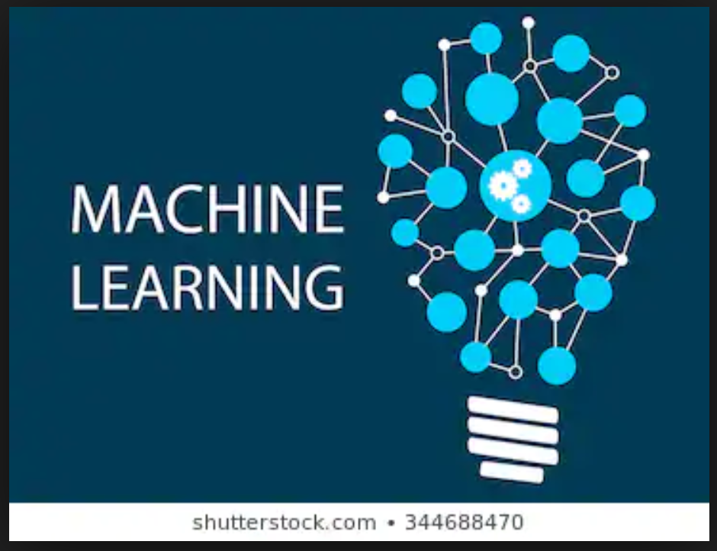
Machine LearninG

Slide 15
definitions
Artificial Intelligence (AI)
Concerned with methods for improving the knowledge and performance of an intelligent agent over time in response to the agent’s experience in the world
Machine Learning (ML)
Sub field of AI. Also called Predictive Modelling
Essentially a collection of methods for extracting (usually predictive) models from data
Given a set of attributes A, “predicts” B.
Knowledge Discovery and Data Mining (KDD)
An offshoot of ML
Extraction of useful information and knowledge from large volume of data in order to improve decision making
Sometimes also referred to as Data Science
Notes:
Maps A to B
Example of Richard Fiarbanks and Nigel Moris with Signet bank
Data seen as an asset now

Slide 16
Types of kdd tasks
9 broad type of tasks in KDD
Classification
Regression
Similarity matching
Clustering
Co-occurrence
Profiling
Link prediction
Data reduction
Causal mapping

Slide 17
Types of kdd tasks
Classification
Attempts to predict which of a small set of classes a given individual belongs to
“Is a specific customer likely to respond to a given offer?”
“Will respond” and “will not respond” are the two classes here
Class probability estimation
Regression
Attempts to estimate the numerical value of some variable for an individual
“How much will a given customer use the service?”
This estimation is typically done using a mathematical model created by looking at other individuals where the target numerical value is known
Notes:
Could also be for a group of individuals. i.e. which set of customers are likely to …
There could be more than 2 classes also
What customers are likely to not renew their contracts
My individual I mean a member (or a row in the DB or Excel sheet)

Slide 18
Types of kdd tasks
Similarity matching
Finding individuals similar to a given individual
“Find companies similar to my best business customers”
Product recommendation
Clustering
Group individuals in a population together by their similariy but not driven by any specific purpose
“Do our customers form natural groups or segments?”
Useful in preliminary domain exploration
Decision making like “how should our customer support team be structured”?
Notes:
Find employees that are similar to my most successful employee in the project

Slide 19
Types of kdd tasks
Co-occurrence grouping
Also known as frequent itemset mining or market-basket analysis
Works on transaction data
“What items are commonly purchased together?”
Profiling or behaviour description
Attempts to describe the typical behaviour of an individual or a group
“What is the typiczl cell phone usage in this group”
Anomaly detection
Notes:
Co-occurrence could result in recommendation regarding how products are displayed or promotions
Don’t assume that all of these tasks require same type of data and hence any of the tasks could be performed on a data

Slide 20
Types of kdd tasks
Link prediction
Attempts to predict connections between data item, usually suggesting that a link should exist
Since you and X share 10 friends, maybe you will like to add X as your friend
Data reduction
Attempts to replace a large set of data with a smaller set that contains much of the important information of the larger set
Convert a massive data set on summer movie viewing preferences to viewer genre preferences
Causal modelling
Attempts to help us understand which events or actions actually influence other
Generally needs randomized controlled experiments. A/B tests
Notes:
Link prediction is quite often used in Social Networking
Data reduction can also help in uncovering patterns
Case of success of a targeted advertising. Was the advertisement good or was the selection of target customers was good?

Slide 21
Supervised and unsupervised methods
“Do our customers naturally fall into different categories?”
We are not specifying any target attribute or purpose has been specified for grouping
“Can we find group of customers who have particularly high likelihood of cancelling the service after their current contract expires?”
We have a specific target. Will a customer leave or not leave?
In supervised methods, the teacher supervises the learner by carefully providing target information along with a set of examples
Classification and Regression are usually supervised while clustering is unsupervised method

Slide 22

Typical ML or KDD workflow
Business Understanding
Data Understanding
Data
Data Preparation
Deployment
Modelling
Evaluation
Notes:
For other KDD tasks, there is no evaluation or deployment. You get insights or hypothesis from the modeling

Slide 23
workflow
Business Understanding
This is the craft part of such projects
Creative formulation of business requirements in to KDD problems is often key to the great success
What exactly do we want to do? How exactly could we do it?
Data Understanding
Strength and limitations of the data available
Rarely an exact match with the problem
Cost of data. Cost / benefit analysis
Data cleaning / collating
Notes:
For business understanding, talk about employee attrition problem
You want to “improve” the operations of a call center since you have a lot of data. What part can you improve? What data will you need
Historical data is often collected for unrelated purposes or at times for no purpose at all
Data cleansing
This part is common in almost all types of technologies or domain you might be working in

Slide 24
Workflow
Modelling
Typically creating a model that maps a set of attributes A to a target attribute B
It should be “reasonably accurate”
Should provide some advantage over simple / trivial methods
Comprehensibility
Evaluation
Test against a data set. Preferably different from the one that was used to train the model
Do you trust the accuracy?
Is this good enough?
ML tasks are closer to R&D than standard engineering tasks. Many managers used to managing software projects might not be comfortable with this workflow
Notes:
Probability of someone defaulting is very low (maybe 0.5%). A model that simply predicts that no one will default is still very accurate but doesn’t add any value
Many times you need to sell the model to management that might not be very conversant with complex methodologies
Will you get the same type of fit when you test against a different dataset?
Give example of Hello Alexa. How it will be modelled and tested etc
Concept of Confidence

Slide 25
classification
Supervised segmentation is one of the most common method
Works by segmenting (splitting) the entity space along most “informative attribute”
“Information” is a quantity that reduces uncertainty about something or some classification
Height attribute is quite attribute while estimating weight of a person
Employment status and likelihood of default
“An unemployed person with more than 50K of outstanding credit and less than 45 years of age is quite likely to default”
An informative attribute is the one that increases the homogeneity / purity of target values in the resulting segments
Notes:
Explain the process by which the example segmentation might have been reached

Slide 26
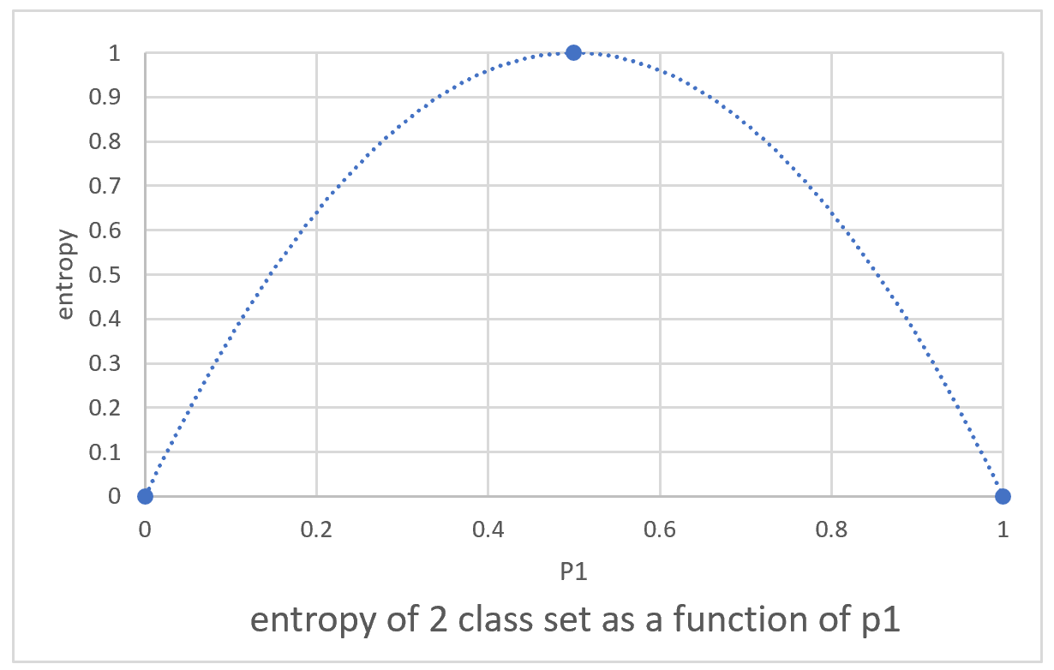
segmentation – technical details
Entropy: A measure of non-uniformity of target values in a segment
Entropy = -p₁ x log(p₁) – p₂ x log(p₂) - ….
Where p_{i} is the probability (relative percentage) of class c_{i} in the segment

Slide 27
segmentation – technical details
Information gain: decrease in entropy (i.e. increase in orderliness) by segmentation on a given attribute
IG = entropy (parent) – (p(c₁) x entropy(c₁) + p(c₂) x entropy(c₂) + …)
Where p(c_{i}) is the proportion of instances belonging to that child

Slide 28
segmentation - Example
No
Yes
Yes
Yes
Yes
No
Yes
No
No
Yes
No
Yes
Head shape – Square, Circle
Body shape – Rectangle, Oval
Body colour – Blue, White
Target value – Yes, No
p(yes) = 7/12 = 0.58, p (no) = 5/12 = 0.42
Entropy = -0.58*log(0.58) – 0.42*log(0.42) = 0.30

Slide 29
segmentation - Example
Circular head
Square head
No
Yes
Yes
Yes
Yes
Yes
No
No
Yes
No
Yes
No
Splitting by head shape
p(yes) = 0.67, p (no) = 0.33
Entropy = 0.28
p(yes) = 0.56, p (no) = 0.44
Entropy = 0.30
IG = 0.30 – ((0.28 * 0.25) + (0.30 * 0.75)) = 0.30 – 0.30 = 0.0

Slide 30
segmentation - Example
Oval body
Rectangular body
No
Yes
Yes
No
No
No
Yes
Yes
Yes
No
Yes
Yes
Splitting by body shape
p(yes) = 0.33, p (no) = 0.67
Entropy = 0.28
p(yes) = 0.83, p (no) = 0.17
Entropy = 0.20
IG = 0.30 – ((0.28 * 0.5) + (0.20 * 0.50)) = 0.30 – 0.24 = 0.06

Slide 31
segmentation - example
Bo
Body shape
Oval
Rectangular
Bo
Bo
Head shape
Body colour
Circular
Square
White
Blue
Yes
No
Yes
No

Slide 32
Visualizing the classification tree
55 years
45 years
Age
50K
Balance
Notes:
Final partitions need not be pure
Could even assign probabilities. Useful for ranking

Slide 33
Supervised Segmentation
One of the most popular data mining procedures
Comprehensible
Relatively efficient
Supported in most data mining libraries
Can also be represented as a set of rules.
If (Balance < 50K) And (Age < 50) Then class = Write-off
If (Balance < 50K) And (Age >= 50) Then class = No Write-off
If (Balance >= 50K) And (Age < 45) Then class = Write-off
If (Balance >= 50K) And (Age >= 45) Then class = No Write-off

Slide 34
Fitting model to data
Model specified as a structure (could be a mathematical equation) with certain parameters left unspecified
Compute the most optimal values for these parameters to complete the model
Also called “parameter learning”, “parameter modelling” or “function fitting”
Use this structure / equation to compute the target value or class for new entries

Slide 35
Revisiting the credit write-off example
Linear classifier
Age = m * Balance + c OR
M * Balance – Age + c = 0
Classification function
Class(x) = “No Write-off” if CF(x) <= 0
“Write-off” if CF(x) > 0
Age
Balance
Notes:
Final partitions need not be pure
Could even assign probabilities. Useful for ranking
X is a given combination of Age and Balance

Slide 36
Linear classifier
Many varieties of function fitting techniques with Linear modelling being the most common
Weighted sum of attribute values
f(x) = w₀ + w₁*x₁ + w₂*x₂ + ….
Compute (learn) the most optimum weights using the given dataset
Assuming all the attributes have been normalized to the same range, absolute value of weights indicate the relative importance of the corresponding attribute

Slide 37
Choosing the best line!
Many ways to fit a line!
Depends upon what we are trying to achieve
Define an Objective Function that needs to be minimized
Regression is an extension of the same concept
Notes:
How do you choose the best line?
Choosing the line is the “learning” part in this model
What do you optimize the weights for?
Objective functions should represent the business need
SVM, Absolute error, Least Squared Error etc.

Slide 38
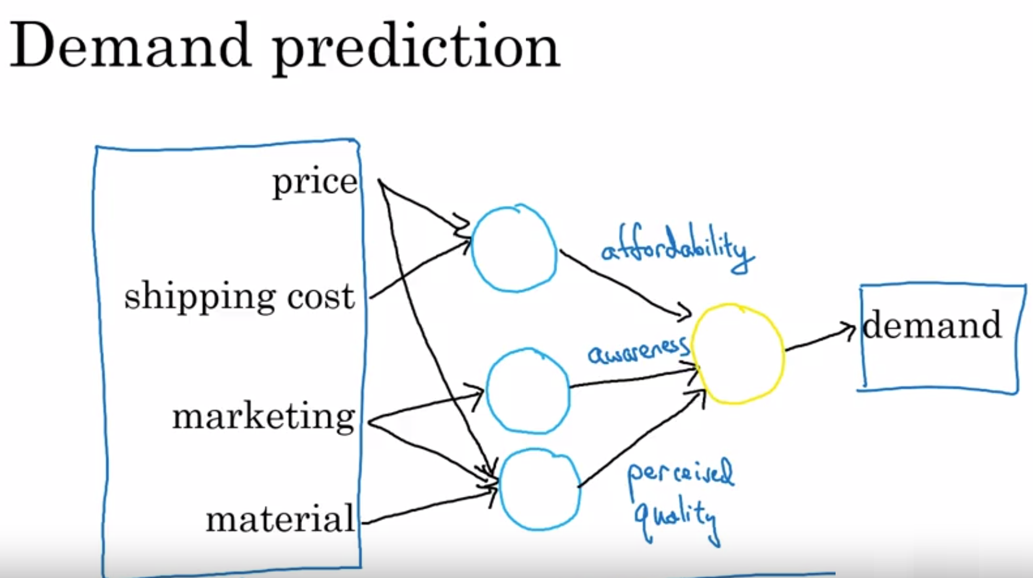
Deep learning / neural networks
Stack of (usually linear) models
Original features at the bottom of the stack and more complex “learnt features” at the next level and so on
Normally only the final target are given
Stack of models represented by one huge parameterized numeric function

Slide 39
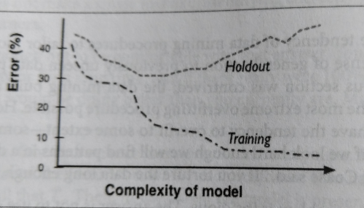
Overfitting avoidance
If you look hard enough, you will find structure in a dataset even if it is there by chance
More complex the model, more closely it fits the data (overfits)
Compare with accuracy against holdout data
Find the sweet spot for complexity of model
Notes:
Seeing patterns in cloud
Conspiracy theories
Extreme example of “referencing”

Slide 40
Thank you

Slide 41
Works cited
Data Science for Business by Foster Provost & Tom Fawcett
Machine Learning for Hackers by Drew Conway and John Myles White
AI for everyone – Course by Andrew Ng on Coursera

